Slide 1
Relationship between Occupational Injury Probability and Risk Perception in Industry Committee Update Meeting 04/20/2021 Yenny Fariñas Diaz
Department of Environmental Health Sciences
Robert Stempel College of Public Health and Social Work

Slide 2
Committee Members
Committee Member | Department
Dr. Roberto Lucchini, Professor Major Professor (Committee Chair) | Dept. of Environmental Health Sciences
Dr. Jeremy Chambers, Ph.D, Assistant Professor Director of Doctoral Programs, Department of Environmental Health Sciences Committee Member | Dept. of Environmental Health Sciences
Dr. Shanna L. Burke, MSW, LCSW, PhD, Assistant Professor Committee Member | Dept. of School of Social Work
Dr. Deodutta Roy, PhD, Professor Committee Member | Dept. of Environmental Health Sciences
Dr. Emir Veledar, Ph.D., Courtesy Graduate Faculty Appointment Director of Biostatistics and Predictive Analytics at Baptist Health Committee Member | Dept. of Biostatistics

Slide 3
Background
Understanding risk perception and the associated human behaviors are key in understanding how people react to hazards and how a culture of safety is developed.
How the individual perceives the risk associated with their work may determine how they will react in the event of an incident or a harmful exposure and this may be seen reflected in workplace injuries.
Secondary data analysis of documented workplace injuries of laboratory workers in educational and healthcare institutions and manufacturing. It will examine the Relationship between Risk Perception and Occupational Injuries.
The general intent of the study is to understand how risk perception and injury experience affects safety behaviors in order to propose hazard mitigation interventions that consider the human factors.

Slide 4
Hypothesis
Hypothesis:
We hypothesize that risk perception is higher in occupations with a lower fatalities/injuries experience.
We also hypothesize that occupations with a lower risk experience have a higher fatalities/injuries experience.
Relative Fatality Index
Risk perception
Risk
Figure 1: Graphical Representation of Hypothesis.

Slide 5
Specific Aims
Aim1:
To examine the likelihood that administrative occupations have a higher fatalities/injuries experience than those in non-administrative occupations.
Will evaluate:
if there is a correlation between occupational injuries and fatalities in administrative and non-administrative type of occupations.
Aim 2:
To examine the likelihood that risk perception is lower in administrative occupations versus in a non-administrative occupations.
Will evaluate:
if the effect of variables such as: Length of service, Age, Gender, Type of work has on risk perception.

Slide 6
DATA STORAGE

Slide 7
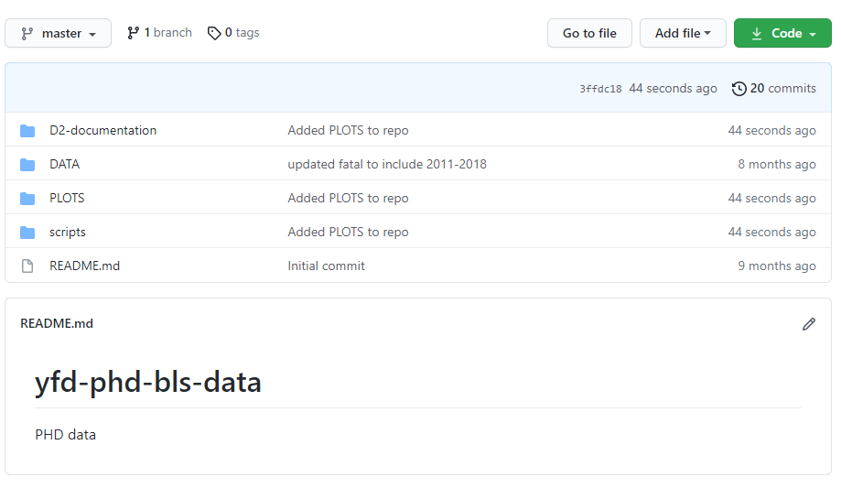
Data Repository Location
https://github.com/ehsintegration/yfd-phd-bls-data
All DATA is kept in the GITHUB depository located in the link above.
The SCRIPTS folder contains the analysis and (RESULTS) for each variable where the graphs are also embed and located within the program itself, or within the PLOTS directory.
DATA
PLOTS
SCRIPTS
Figure 2: GITHUB repository location.

Slide 8
Example Data:
The following two slides represent the plots found in the SCRIPTS and PLOTS directories.
More data can be found within the PLOTS directory:
The next slide shows the plot of relative fatal log10 index vs increasing SOC categories level 1. 11XXXX, 12XXXX, 13XXXX…., for the GENDER category.
The slide after that, shows the plot of relative fatal log10 index vs increasing SOC categories level 6. 110000, 111000, 111010…., for the GENDER category.
OBSERVATIONS:
Since, the relative index is a function of, y_{log} = [-1 * log10(y_{data})], then a higher relative log index value correlates to a small fatality/injury rate. Since the categories on the x axis are ranked from left to right with increasing job risk. We can see a positive slope, that indicates that people with a higher perception of risk have a lower fatality rate.
We also believe that we see a relationship of injury count, fatal count, and soc_code combination. Therefore, we should be able to predict a fatality count given an soc_code and injury count.
Any other suggestions as to what other potential statistical measurements we can perform, would be appreciated?
https://github.com/ehsintegration/yfd-phd-bls-data/tree/master/PLOTS

Slide 9
POPULATION SIZE

Slide 10
Approach: Sample Population and Sample Size
Sample population:
A total of 8 years of Injury, Illness and Fatalities data from the United States Department of labor from 2011 through 2018 in Private Industry in the United States.
The injury and fatality data is representative of various private sector industries reported to the United States Department of labor, of which all will be used for this study.
This study only analyses those injuries deemed to be recordable or resulting in a fatality.
A recordable injury is defined by the Occupational Safety and Health Administration (OSHA) recordkeeping standard in the Code of Federal Regulations as a fatality or “Any work-related injury or illness that results in loss of consciousness, days away from work, restricted work, or transfer to another job. Any work-related injury or illness requiring medical treatment beyond first aid” (OSHA, 29 C.F.R.§1904.7 Subpart C, 2001).
Required Sample size:
Alpha levels will be set at 0.05 (95% confidence level), with a 5% margin of error, therefore requiring a population size of a minimum if 385.
Our analysis in the GIT repository, shows that the collected data points in the study exceeds the required sample size of 385.

Slide 11
DATA OVERVIEW

Slide 12
Data: Approach
The data collected is publicly available as these industries are subject to reporting their injuries, illnesses and fatalities to their corresponding state once an employee has incurred a recordable case and annually to the US Department of Labor Bureau of Labor Statistics.
Data availability: The data will be retrieved from Federal databases from the US Department of Labor (U.S. Bureau of Labor Statistics, 2020).
Multi-screen data search (2011-2018): https://www.bls.gov/iif/data.htm (U.S. Bureau of Labor Statistics, 2020).
Data collected and stored at : https://github.com/ehsintegration/yfd-phd-bls-data/tree/master/DATA
Copyrights, publications, licensing and data protection, : https://www.bls.gov/opub/ (U.S. Bureau of Labor Statistics, 2020).
Licensing: The data retrieved from “Data.gov” can be used without cost or a licensing requirement.
Copyrights, publications: The Bureau of Labor Statistics requests that they be cited when the data is used.
Data protection: The data is protected in an official site “Data.gov” from the US Government and it complies with Computer Fraud and Abuse Act of 1986 and the National Information Infrastructure Protection Act. The data integrity of the injured or deceased employee has already been protected by the collecting entity.

Slide 13
Data: Approach
For our proposed risk analysis, we will be obtaining fatality and workplace injury data from the department of US labor statistics. These variables are GENDER, AGE, LENGTHOFSERVICE, RACE, and SOCJOBCODE.
The SOCJOBCODE is a numerical valued categorical classification system, that is used to encode the occupational type, however it is encoded in such a way, that it can also be used as an independent variable. The SOC job code number is a six-digit number, where the powers of 10 place value, implement a value of manual operation encoding. The numerical range of this encoding is also enumerated in increasing risk order, since the employment classifications at the lower range of value represents an occupation with a higher degree of administrative type work.
Administrative
11-XXXX Management Occupations
13-XXXX Business and Financial Operations Occupations
15-XXXX Computer and Mathematical Occupations
17-XXXX Architecture and Engineering Occupations
19-XXXX Life, Physical, and Social Science Occupations
21-XXXX Community and Social Service Occupations
23-XXXX Legal Occupations
25-XXXX Educational Instruction and Library Occupations
27-XXXX Arts, Design, Entertainment, Sports, and Media Occupations
29-XXXX Healthcare Practitioners and Technical Occupations
31-XXXX Healthcare Support Occupations
33-XXXX Protective Service Occupations
35-XXXX Food Preparation and Serving Related Occupations
37-XXXX Building and Grounds Cleaning and Maintenance Occupations
39-XXXX Personal Care and Service Occupations
41-XXXX Sales and Related Occupations
43-XXXX Office and Administrative Support Occupations
45-XXXX Farming, Fishing, and Forestry Occupations
47-XXXX Construction and Extraction Occupations
49-XXXX Installation, Maintenance, and Repair Occupations
51-XXXX Production Occupations
53-XXXX Transportation and Material Moving Occupations
55-XXXX Military Specific Occupations
Non-Administrative
Figure 3: SOC level 1 risk profile.

Slide 14
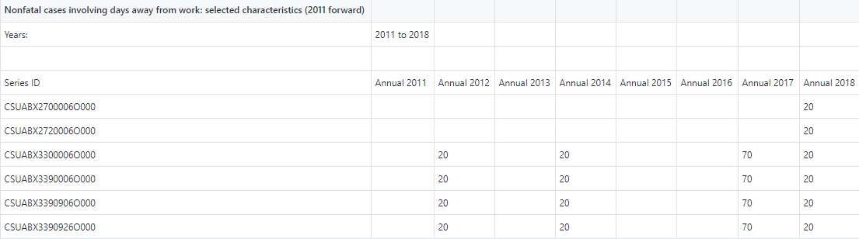
All the data was collected from the US department of Labor and uploaded to a GITHUB repository. A series of Jupyter python programs was created to parse the data for analysis. The data is stored as individual files for each independent variable:
In each file you will find eight sample values for each SOC job category, as shown below:
Data: Methodology (file structure)
Independent Variables → | Age | Gender | Length of Service | Race
Type of Variable → | Categorical Continuous | Categorical | Categorical Continuous | Categorical
 | NF_AGE_14to15_all.xlsx NF_AGE_16to19_all.xlsx NF_AGE_20to24_all.xlsx NF_AGE_25to34_all.xlsx NF_AGE_35to44_all.xlsx NF_AGE_45to54_all.xlsx NF_AGE_55to64_all.xlsx NF_AGE_65plus_all.xlsx NF_AGE_NR_all.xlsx | NF_GENDER_F_all.xlsx NF_GENDER_M_all.xlsx NF_GENDER_NR_all.xlsx | NF_LOS_ltg3mos_all.xlsx NF_LOS_3to11mos_all.xlsx NF_LOS_1to5yr_all.xlsx NF_LOS_5plus_all.xlsx NF_LOS_NR_all.xlsx | NF_RBX_Asian_all.xlsx NF_RDX_Hispanic_all.xlsx NF_REX_Hawaiian_all.xlsx NF_RFX_White_all.xlsx NF_RGX_NR_all.xlsx NF_RHX_Multi_all.xlsx NF_RIX_Hispanic_all.xlsx NF_RCX_Black_AfricanAmerican_all.xlsx NF_RAX_AmericanIndian_AlaskaNative_all.xlsx
Figure 4: File name and content structure.

Slide 15
Data: Analysis (Occupation Type: SOC Standard Occupational Classification)
Each SOC job category number is used to encode a branch of occupation. The SOC job code consists of 6 numbers, that when read from left to right will further subdivide the group into more specifications. The job code is used to denote a location in a TREE of occupations.
11-0000 Management Occupations
11-1000 Top Executives
11-1010 Chief Executives
11-1011 Chief Executives
11-1020 General and Operations Managers
11-1021 General and Operations Managers
11-1030 Legislators
11-1031 Legislators
11-2000 Advertising, Marketing, Promotions, Public Relations,
and Sales Managers
11-2010 Advertising and Promotions Managers
11-2011 Advertising and Promotions Managers
11-2020 Marketing and Sales Managers
11-2021 Marketing Managers
11-2022 Sales Managers
11-2030 Public Relations Managers
11-2031 Public Relations Managers
11-3000 Operations Specialties Managers
11-3010 Administrative Services Managers
11-3011 Administrative Services Managers
11-3020 Computer and Information Systems Managers
.
.
.
.
.
11-9140 Property, Real Estate, and Community AssociationManagers
11-9141 Property, Real Estate, and Community Association Managers
11-9150 Social and Community Service Managers
11-9151 Social and Community Service Managers
11-9190 Miscellaneous Managers
11-9199 Managers, All Other
13-0000 Business and Financial Operations
13-1000 Business Operations Specialists
13-1010 Agents and Business Managers of Artists, Performers, and Athletes
13-1011 Agents and Business Managers of Artists, Performers, and Athletes
13-1020 Buyers and Purchasing Agents
13-1021 Purchasing Agents and Buyers, Farm Products
13-1022 Wholesale and Retail Buyers, Except Farm Products
13-1023 Purchasing Agents, Except Wholesale, Retail, and Farm Products
13-1030 Claims Adjusters, Appraisers, Examiners, and Investigators
13-1031 Claims Adjusters, Examiners, and Investigators
13-1032 Insurance Appraisers, Auto Damage
13-1040 Compliance Officers, Except Agriculture, Construction, Health and Safety, and Transportation
13-1041 Compliance Officers, Except Agriculture, Construction, Health and Safety, and Transportation
13-1050 Cost Estimators
13-1051 Cost Estimators
13-1060 Emergency Management Specialists
13-1061 Emergency Management Specialists
13-1070 Human Resources, Training, and Labor Relations
.
.
(https://github.com/ehsintegration/yfd-phd-bls-data/blob/master/DATA/SOC_all.xlsx)
The following file contains the standard occupational coding that is used to index the data.

Slide 16
Data Analysis: SOC (continued)
Here is an example of the TREE encoding system, with further descendant selectivity. The “X”s below can be viewed as a don’t care.
The occupational code is a 6 different number that clusters occupations into finer and finder resolutions.
Therefore a occupational index of “23XXXX” will select all “legal occupations”
And a occupational index of “231XXX” will select all “lawyers, judges, and related workers”
And a occupational index of “231011” will select all “lawyers”
Administrative
11-XXXX Management Occupations
13-XXXX Business and Financial Operations Occupations
15-XXXX Computer and Mathematical Occupations
17-XXXX Architecture and Engineering Occupations
19-XXXX Life, Physical, and Social Science Occupations
21-XXXX Community and Social Service Occupations
23-XXXX Legal Occupations
25-XXXX Educational Instruction and Library Occupations
27-XXXX Arts, Design, Entertainment, Sports, and Media Occupations
29-XXXX Healthcare Practitioners and Technical Occupations
31-XXXX Healthcare Support Occupations
33-XXXX Protective Service Occupations
35-XXXX Food Preparation and Serving Related Occupations
37-XXXX Building and Grounds Cleaning and Maintenance Occupations
39-XXXX Personal Care and Service Occupations
41-XXXX Sales and Related Occupations
43-XXXX Office and Administrative Support Occupations
45-XXXX Farming, Fishing, and Forestry Occupations
47-XXXX Construction and Extraction Occupations
49-XXXX Installation, Maintenance, and Repair Occupations
51-XXXX Production Occupations
53-XXXX Transportation and Material Moving Occupations
55-XXXX Military Specific Occupations
We can also see that the numbering system increases in a numerical order, in proportionality to human physical manual difficulty.
Non-Administrative
Figure 3: SOC level 1 risk profile.

Slide 17
MODEL

Slide 18
Approach: Dependent and Independent Variables
Summary of Variables:
Dependent Variable: 1 main outcome variable of interest is risk perception.
Independent variables of interest: 7 (6 for Injuries and Illnesses; 1 for Fatalities).
Table 1
Dependent and Independent Variables
Dependent Variables | Types of Variables
Occupational Recordable Injury and Illness → Risk Perception | Continuous
Independent Variables | Types of Variables
Age, Length of Service, Hours on the Job | Categorical and Continuous
Gender, Race, Occupation Type, Event or Exposure | Categorical
Fatalities | Continuous

Slide 19
Approach: Description of Independent Variables
Table 2
Description of Independent Variables
Independent Variables → | Age | Gender | Length of Service | Race | Occupation Type | Hours on the Job | Event or Exposure | Fatalities
Type of Variable → | Categorical Continuous | Categorical | Categorical Continuous | Categorical | Categorical | Categorical Continuous | Categorical | Continuous
 | 14-15 Yrs.' 16-19 Yrs.' 20-24 Yrs.' 25-34 Yrs.' 35-44 Yrs.' 45-54 Yrs.' 55-64 Yrs.' 65 Yrs.' + Not Reported | Male Female Not Reported | < 3 Mos. 3-11 Mos. 1-5 Yrs.' 5 Yrs.' Not reported | Asian African American/Black (non-Hispanic) Hispanic/Latino American Indian/ Alaskan Native Arab/Middle Eastern/ Arab American Native Hawaiian or Other Pacific Islander Not Reported White Multi Race Hispanic and Other | Life Scientists Biological Scientists Medical Scientists Physical Scientists Chemists & Material Scientists Chemists Biological Technicians Chemical Technicians Health Technologists & Technicians Clinical Laboratory Technologists & Technicians Medical & Clinical Lab Techologists Medical & Clinical Lab Technicians Production Occupations (for Manufacturing) | Before shift began (< 1) < 1hr (0-1) 1- 2 Hrs. 2- 4 Hrs. 4- 6 Hrs. 6- 8 Hrs. 8- 10 Hrs. 10-12 Hrs. 12-14 Hrs. 14-16 Hrs. > 16 Hrs. Not Reported | Violence & other injuries by persons or animals Transportation incidents Fires & explosions Fall, slip and Trips Exposure to harmful substances or environment Contacts with objects and equipment Overexertion and bodily reaction | Number of Fatalities for each Independent Variable

Slide 20
Occupation Type : SOC Standard Occupational Classification
The 2018 Standard Occupational Classification (SOC) system is a federal statistical standard used by federal agencies to classify workers into occupational categories for the purpose of collecting, calculating, or disseminating data. All workers are classified into one of 867 detailed occupations according to their occupational definition.
To facilitate classification, detailed occupations are combined to form 459 broad occupations, 98 minor groups, and 23 major groups. Detailed occupations in the SOC with similar job duties, and in some cases skills, education, and/or training, are grouped together.

Slide 21
Occupation Type: SOC Standard Occupational Classification
(https://github.com/ehsintegration/yfd-phd-bls-data/blob/master/DATA/SOC_all.xlsx)
The following file contains the standard occupational coding that is used to index the data.
11-0000 Management Occupations
11-1000 Top Executives
11-1010 Chief Executives
11-1011 Chief Executives
11-1020 General and Operations Managers
11-1021 General and Operations Managers
11-1030 Legislators
11-1031 Legislators
11-2000 Advertising, Marketing, Promotions, Public Relations,
and Sales Managers
11-2010 Advertising and Promotions Managers
11-2011 Advertising and Promotions Managers
11-2020 Marketing and Sales Managers
11-2021 Marketing Managers
11-2022 Sales Managers
11-2030 Public Relations Managers
11-2031 Public Relations Managers
11-3000 Operations Specialties Managers
11-3010 Administrative Services Managers
11-3011 Administrative Services Managers
11-3020 Computer and Information Systems Managers
.
.
.
.
.
11-9140 Property, Real Estate, and Community AssociationManagers
11-9141 Property, Real Estate, and Community Association Managers
11-9150 Social and Community Service Managers
11-9151 Social and Community Service Managers
11-9190 Miscellaneous Managers
11-9199 Managers, All Other
13-0000 Business and Financial Operations
13-1000 Business Operations Specialists
13-1010 Agents and Business Managers of Artists, Performers, and Athletes
13-1011 Agents and Business Managers of Artists, Performers, and Athletes
13-1020 Buyers and Purchasing Agents
13-1021 Purchasing Agents and Buyers, Farm Products
13-1022 Wholesale and Retail Buyers, Except Farm Products
13-1023 Purchasing Agents, Except Wholesale, Retail, and Farm Products
13-1030 Claims Adjusters, Appraisers, Examiners, and Investigators
13-1031 Claims Adjusters, Examiners, and Investigators
13-1032 Insurance Appraisers, Auto Damage
13-1040 Compliance Officers, Except Agriculture, Construction, Health and Safety, and Transportation
13-1041 Compliance Officers, Except Agriculture, Construction, Health and Safety, and Transportation
13-1050 Cost Estimators
13-1051 Cost Estimators
13-1060 Emergency Management Specialists
13-1061 Emergency Management Specialists
13-1070 Human Resources, Training, and Labor Relations
.
.
Figure 7: Sample SOC table listing.

Slide 22
Occupation Type: Standard Occupational Classification (SOC Level 1)
11-XXXX Management Occupations
13-XXXX Business and Financial Operations Occupations
15-XXXX Computer and Mathematical Occupations
17-XXXX Architecture and Engineering Occupations
19-XXXX Life, Physical, and Social Science Occupations
21-XXXX Community and Social Service Occupations
23-XXXX Legal Occupations
25-XXXX Educational Instruction and Library Occupations
27-XXXX Arts, Design, Entertainment, Sports, and Media Occupations
29-XXXX Healthcare Practitioners and Technical Occupations
31-XXXX Healthcare Support Occupations
33-XXXX Protective Service Occupations
35-XXXX Food Preparation and Serving Related Occupations
37-XXXX Building and Grounds Cleaning and Maintenance Occupations
39-XXXX Personal Care and Service Occupations
41-XXXX Sales and Related Occupations
43-XXXX Office and Administrative Support Occupations
45-XXXX Farming, Fishing, and Forestry Occupations
47-XXXX Construction and Extraction Occupations
49-XXXX Installation, Maintenance, and Repair Occupations
51-XXXX Production Occupations
53-XXXX Transportation and Material Moving Occupations
55-XXXX Military Specific Occupations
SOC Level 1 – Cumulative Count
The X’s represent a don’t care condition. Which means it is a wildcard that represents all possible values.
XXXX-mask
This XXXX-mask nomenclature represents a cumulative count for all sublevel occupations within that structure.
Our mathematical analysis scripts parse all of the sublevel occupations and groups them to obtain a final count for the complete group.
Figure 3: SOC level 1 risk profile.

Slide 23
Approach: Description of Independent Variables (file names in data repository)
https://github.com/ehsintegration/yfd-phd-bls-data/tree/master/DATA
Table 3
Description of Independent Variables (File List) , list of data files for each variable.
Independent Variables → | Age | Gender | Length of Service | Race
Type of Variable → | Categorical Continuous | Categorical | Categorical Continuous | Categorical
 | NF_AGE_14to15_all.xlsx NF_AGE_16to19_all.xlsx NF_AGE_20to24_all.xlsx NF_AGE_25to34_all.xlsx NF_AGE_35to44_all.xlsx NF_AGE_45to54_all.xlsx NF_AGE_55to64_all.xlsx NF_AGE_65plus_all.xlsx NF_AGE_NR_all.xlsx | NF_GENDER_F_all.xlsx NF_GENDER_M_all.xlsx NF_GENDER_NR_all.xlsx | NF_LOS_ltg3mos_all.xlsx NF_LOS_3to11mos_all.xlsx NF_LOS_1to5yr_all.xlsx NF_LOS_5plus_all.xlsx NF_LOS_NR_all.xlsx | NF_RBX_Asian_all.xlsx NF_RDX_Hispanic_all.xlsx NF_REX_Hawaiian_all.xlsx NF_RFX_White_all.xlsx NF_RGX_NR_all.xlsx NF_RHX_Multi_all.xlsx NF_RIX_Hispanic_all.xlsx NF_RCX_Black_AfricanAmerican_all.xlsx NF_RAX_AmericanIndian_AlaskaNative_all.xlsx

Slide 24
Approach: Description of Independent Variables
https://github.com/ehsintegration/yfd-phd-bls-data/tree/master/DATA
Table 4
Description of Independent Variables (File List)
Independent Variables → | Hours on the Job | Event or Exposure | Fatalities
Type of Variable → | Categorical Continuous | Categorical | Continuous
 | Before shift began (< 1) < 1hr (0-1) 1- 2 Hrs. 2- 4 Hrs. 4- 6 Hrs. 6- 8 Hrs. 8- 10 Hrs. 10-12 Hrs. 12-14 Hrs. 14-16 Hrs. > 16 Hrs. Not Reported | NF_E1X_In_UnIn_Animal_all.xlsx NF_E2X_Transportion_all.xlsx NF_E3X_Fire_Explosion_all.xlsx NF_E4X_Falls_Slip_Trip_all.xlsx NF_E5X_Exposure_all.xlsx NF_E6X_Contact_all.xlsx NF_E7X_Overex_all.xlsx NF_EXX_All_other_all.xlsx | FATAL_all.xlsx

Slide 25
Approach: Model
Data Selector
---2011
---2012
..
---2018
---2011
---2012
..
---2018
---2011
---2012
..
---2018
Injury Data
(Independent Variable)
Scientist:
191000 Life Scientist
191020 Biological Scientist
192030 Chemist Scientist
.
.
Independent Variables
Age
Length of Service
Hours at Work
Gender
Race
Event type
Laboratories:
292010 Clinical Laboratory
292011 Medical Laboratory
.
.
Fatality Data
(Independent Variable)
Production:
113050 Production Managers
435060 Production Clerks
510000 Production Occupations
.
.
Dependent Variable
Risk Perception-> Injuries
Figure 5: Risk Perception Model.

Slide 26
MATHEMATICAL OVERVIEW

Slide 27
Mathematical Summary:
Now that we are familiar with the data files and their contents, we can further explore the type of data collected and the reasoning behind it.
We have one dataset for all FATAL counts for each SOC job code.
We also have multiple datasets for different INJURY lost work dates, where the counts are organized by AGE, GENDER, RACE, LENGTH OF SERVICE.
In our analysis we are creating a single averaged value for each of the eight years, for each SOC job code. Then we will be taking the log10 of this value and then analyzing the distribution. Therefore, the mathematical process will be:
Risk Perception_{logvalue} = -1 * LOG10 [ AVG(FATAL_COUNT / INJURY_COUNT) ]
The logarithmic equation above was used for two reasons:
To factor out the total population size:
(FATAL_COUNT / POPULATION_SIZE) / (INJURY_COUNT / POPULATION_SIZE) = FATAL_COUNT / INJURY_COUNT
To create a factor, where the magnitude of the index will demonstrate fatalities normalized to injuries.
To create a risk perception index.

Slide 28
Mathematical Summary: Risk Perception Defined
Fatal risk log factor (risk perception) = RP_{logvalue} = -1 * LOG10 [ AVG(FATAL_COUNT / INJURY_COUNT) ]
The “Fatal risk log factor”, is not only the log of fatalities count divided by injuries count, but also a measure of risk perception.
In our analysis we will end up with a graph that represents risk perception vs a measure of risk. We will use this graph to analyze the overall response of the data.
Risk perception index
risk perception
Risk
risk
Figure 6: Graphical Representation of Hypothesis with Risk labels.

Slide 29
CURRENT RESULTS

Slide 30
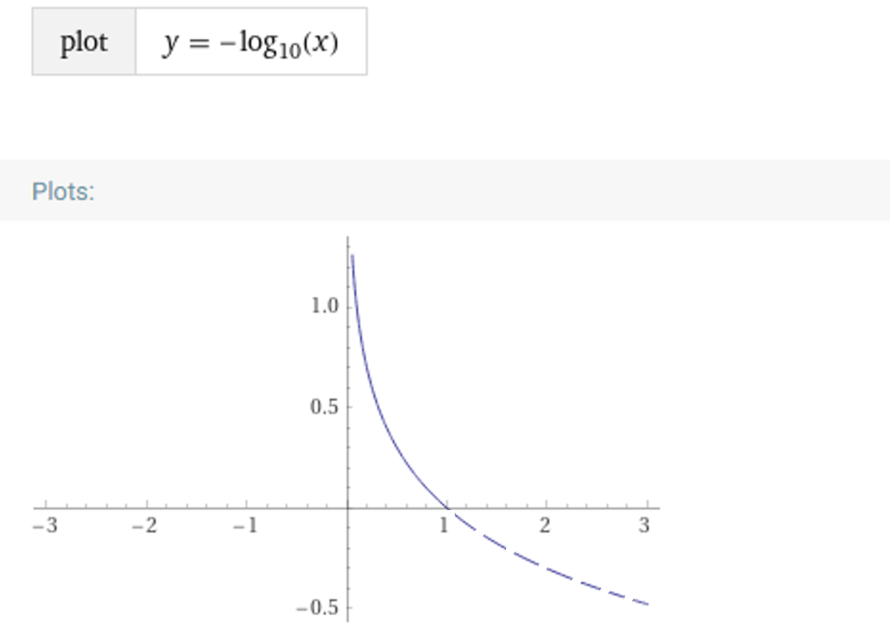
Example Data: Risk Perception Conversion Equation
Risk perception index function:
y_{log} = [-1 * log10(y_{data})]
RP_{log} = [-1 * log10(FI_{data})]
The data is being converted to a semi-log plane, so that it forms a linear distribution that can be easily analyzed.
The formula above is how we generate the risk perception index from the fatality/injury rate.
RP_{logvalue}
(risk perception index)
FI
(rate)
Figure 8: Risk Perception Equation Graph Transfer Example.

Slide 31
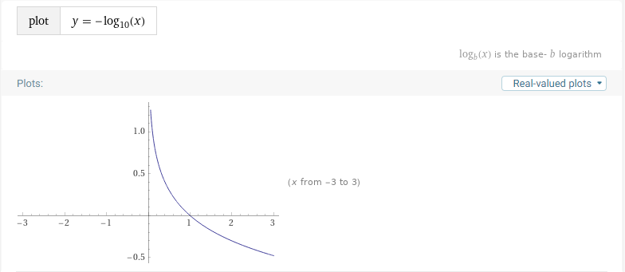
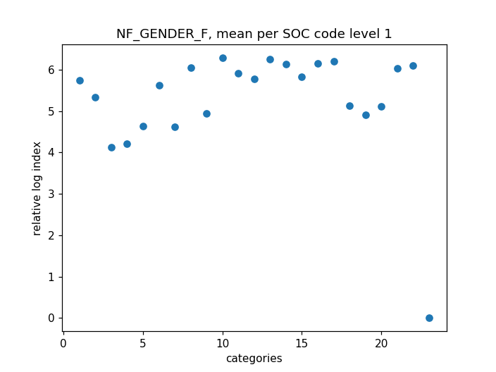
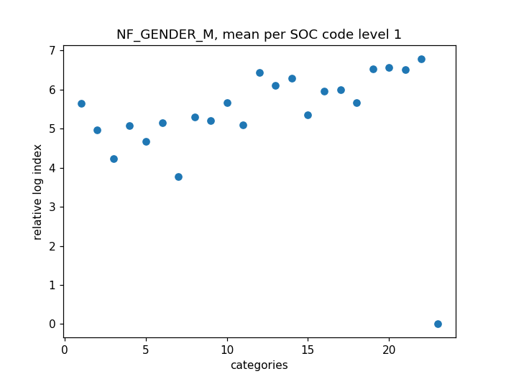
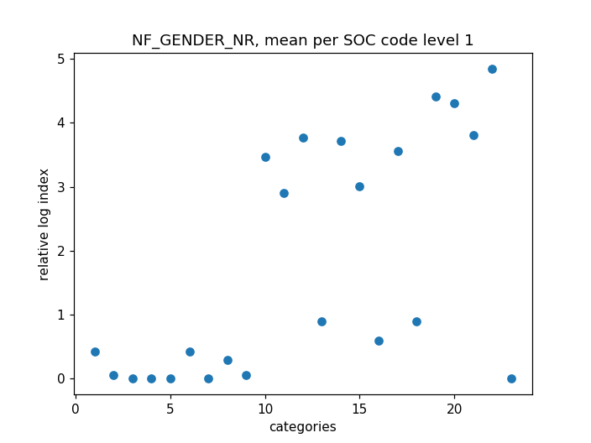
Example Data: SOC level 1 Data for Gender
Since, the relative index is a function of:
RP_{logvalue} = [-1 * log10(FI_{rate})],
then a higher relative log index value, correlates to a smaller fatality/injury rate.
Since the categories on the x axis are ranked from left to right with increasing job risk. We can see a positive slope, that indicates that people with a higher perception of risk have a lower fatality rate.
Figure 9: Risk Perception Equation
risk perception
risk
Figure 9a: Female Averaged Data Distribution
Figure 9b: Male Averaged Data Distribution
Figure 9c: Not reported Averaged Data Distribution

Slide 32
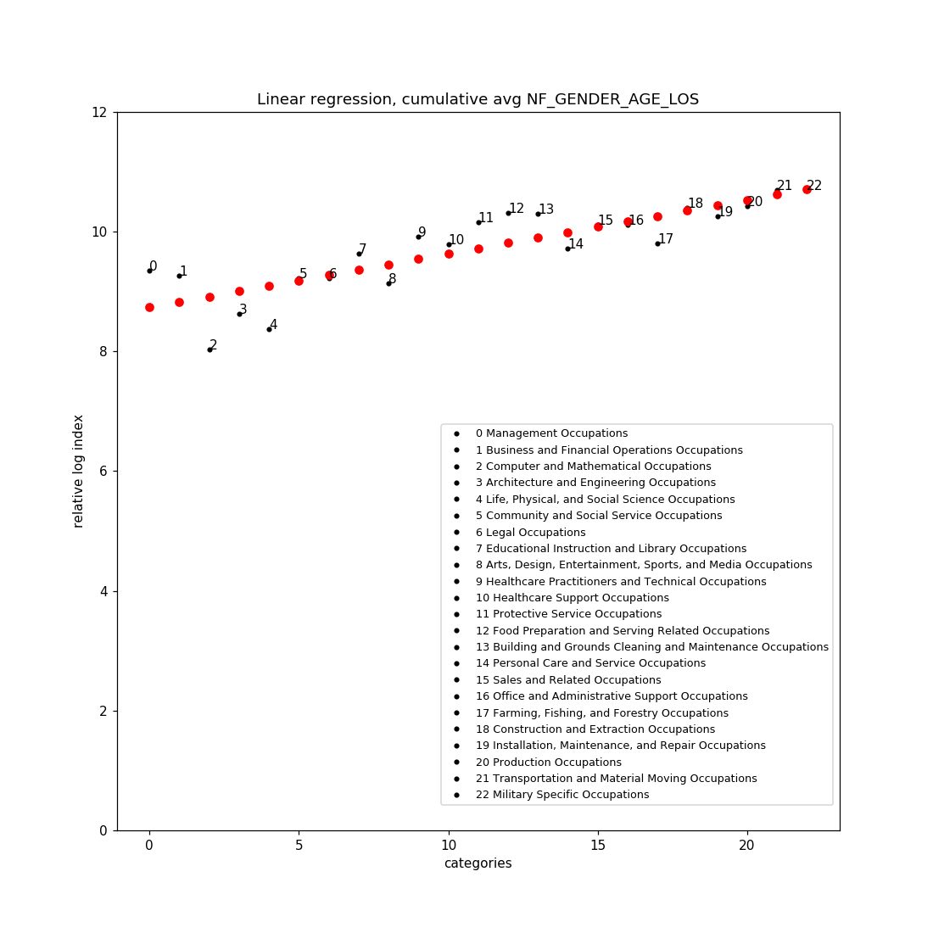
Example Data: Cumulative Averaged Values for GENDER/AGE/LOS, SOC level 1
The graph to the right was created by averaging all the occupational categorical fatality log values. This was done for GENDER, AGE, and LOS (length of service).
RACE also produces a positive slope, however, the correlation of the values to the linear regression, was a better match (better r) when RACE data was not averaged.
risk perception
risk
Figure 10: Cumulative Averaged Data Regression.
Figure 9: Risk Perception Equation.
Notes:
Greater Risk Perception = less fatalities
Fatalities divided by Injuries --→ Risk perception profile
Higher RP, lower fatality rate

Slide 33
Example Data: Conclusion Summary
Since, the relative index is a function of:
y_{log} = [-1 * log10(y_{data})],
then a higher relative log index value, correlates to a smaller fatality/injury rate.
The categories on the x axis are ranked from left to right with increasing job risk. We can see a positive slope, that indicates that people with a higher perception of risk have a lower fatality rate.
The value for index 0 regression, is 8.73 (fatal log index)
The value for index 22 regression is 10.71 (fatal log index)
Since these are log values they are converted with:
FI_{rate} = 10 ^ (-1 * RP_{logvalue})
Therefore:
The real FI rate for regression index 0 , is 1.841e-09
The real FI rate for regression index 22, is 1.94e-11 (smaller)
This means that the occupation with the most risk for fatality being Military Specific Occupations, actually had the smallest real fatality value (highest perception index). The occupation with the least perceived risk, Management Occupations, had the largest real fatality value (lowest perception index).
Index 22
Index 0
risk perception
risk
Figure 11: Indexed Cumulative Averaged Data Regression.

Slide 34
Example Data: Conclusion Summary
FI_Rate_{value} = 10 ^ (-1 * RiskPerception_{logvalue})
The occupation with the least perceived risk, Management Occupations, had the largest real fatality value (lowest perception index).
For index 0 regression:
8.73 (lower risk perception index)
1.841e-09 (largest fatality/injury)
The occupation with the most risk for fatality being Military Specific Occupations, had the smallest real fatality value (highest perception index).
For index 22 regression:
10.71 (higher risk perception index)
1.94e-11 (smallest fatality/injury )
Index 22
Index 0
risk perception
risk
Figure 11: Indexed Cumulative Averaged Data Regression.
Notes:
Why selected the Log Equation used?
Because some data has large values and other small. By taking the log it allows us to look at the data in as a linear distribution.
Then took the anti log in order to convert back to a true (numerical) fatality/injury rate (independent of occupation size).
The X value is risk.

Slide 35
NEXT STEPS

Slide 36
Next Steps
Analysis:
Need further statistical analysis to look at the relationship between the linear regression line and the actual data.
Analyze Occupation.
Race does not appear to be a factor affecting.

Slide 37
Next Steps : Statistical Options
Table 5
Statistical options.
Statistical Analysis Selected | Why | Comments
Pearson’s correlations will be used to determine the relationship between risk exposure and injury. | Measures the association between the variables. Used to measure strength of the association. | Used to find R-Squared.
A univariate linear regression model will be used to investigate the relationship between injury status and individual potential risk factors. | Used to determine single variable relationship between dependent and independent variables. | Single variable regression equation.
A multivariate linear regression model will be used to examine the influence of a combination of risk factors for becoming injured. | Used to determine a multi variable relationship between the independent variables and the dependent. | All variable regression equation.

Slide 38
Next Steps : Statistical Options
Table 5 (cont.)
Statistical options.
Statistical Analysis Selected | Why | Comments
Covariates will be fitted into the model using a forward selection procedure and will retain in the final linear regression model if they reached a statistical threshold of p<0.10 or were of significance. | Begin with no candidate variables in the model. Select the variable that has the highest R-Squared. (from Pearson) Select the candidate variable that increases R-Squared the most. Stop adding variables when none of the remaining variables are significant p<0.10. | Used to find independent variables for the final regression model.
A logistic regression will be used to investigate the relationship between injury severity and possible risk factors. | Can analyze cut offs, binary categories. Example, does having more than 5 years experience a factor, also analyze age cut offs, or gender. | Binary category analysis.
All statistical analysis will be conducted using Jupyter and/or R Studio, which is a data analytics tools that is commonly being used to analyze publicly available data. The data will be pulled from DOL but it will be stored in the Github depository. | https://github.com/ehsintegration/risk-perception Python will help with data acquisition, and R can be used in parallel with python. Jupyter notebook allows for dual usage (R and Python) in a notebook setting. Example: https://github.com/tobywise/covid19-risk-perception | Jupyter’s notebook format models, Mathematica’s notebook style.

Slide 39
LIMITATIONS/
RISK

Slide 40
Limitations / Potential Problems / Pitfalls and Risks
Limitations:
The study is limited to publicly available occupational injury data in the United States.
Since the injured population cannot be surveyed for risk perception, risk perception inferences will be made based on previous literature research.
There is no OSHA compliance data specific to the laboratory with the documented recordable case.
The study will not evaluate the existence of an association between compliance violations and injuries within the organization reporting the injury, illness or fatality. Therefore, based on the data available we will not be able to determine if there is an association between compliance, previous history of safety violations and the injured employee’s perception of risk.
Potential Problems / Pitfalls:
The current data interface has changed and data the process of collecting the data is now more cumbersome than before. There is no control on future changes.
The Department of Labor currently stores the data in a very fragmented way, which makes it difficult to access and consolidate for use.

Slide 41
Risks and Approvals
Risks:
It poses minimum to no risk but in turn the expected outcomes will provide public health and safety benefits as it will aim to establish an understanding on whether there is a correlation on how risk is perceived and occupational injuries in laboratory settings compared to those in manufacturing.
IRB Approval:
This study will be ran the Subject University Office of Research Integrity to collaborate that the research study is exempt via the Exempt Review process as it is a secondary data review and no people identifiers were collected, thus no identifiers will be included in the dataset for the purpose of the study.

Slide 42
REFERENCES

Slide 43
References
Cambridge University Press (2020). Definition of lagging indicator. Cambridge Advanced Learner's Dictionary & Thesaurus.
National Safety Council (2018, 2017). Injury Facts. Retrieved from: https://injuryfacts.nsc.org.
Occupational Safety and Health Administration (OSHA) (2001). Recording and Reporting Occupational Injuries and Illness, 29 C.F.R.§1904.7 Subpart C.
U.S. Bureau of Labor Statistics (2016). Current Population Survey. Census of Fatal Occupational Injuries.
U.S. Bureau of Labor Statistics (2020). Copyrights, publications, licensing and data protection. https://www.bls.gov/opub
U.S. Bureau of Labor Statistics (2020). Multi-screen data search for Injuries, Illnesses and Fatalities Data from 2011-2018. https://www.bls.gov/iif/data.htm

Slide 44
Figures
Figures
Figure 1: Graphical Representation of Hypothesis.
Figure 2: Risk Perception Model.

Slide 45
Tables
Table 1
Dependent and Independent Variables.
Table 2
Description of Independent Variables.

Slide 46
PROGRESS ACTION PLAN

Slide 47
Timeline (January – Dec 2021)
NIH
Submission
1 month
D2, D3
Committee Review
Sept-Oct’21-D2
Dec’21-D3 Tentative
0-3 months
Report Writing
Send Update.
July-Sept’21
0-3 months
Data Analysis
Aims 1 and 2
Send Update.
May-June’21
0-2 months
Draft Proposal Development
Presentation to Committee
Mar-Apr’21
0-2 months
D1r approval.
Send Update.
Data source Feasibility
Project redesign
Jan- Mar’21
Completed
On track
Late
Notes:
Data collection: 0-3 months
Data analysis for Aim 1 (A and B): 0–3 months
Data analysis for Aim 2: 0–3 months
Preparation of NIH Annual reports: 0–3 months

